Slide 1


Automated Outlier Detection of Georeferences for Large Sets of Taxa
University of Florida

Slide 2
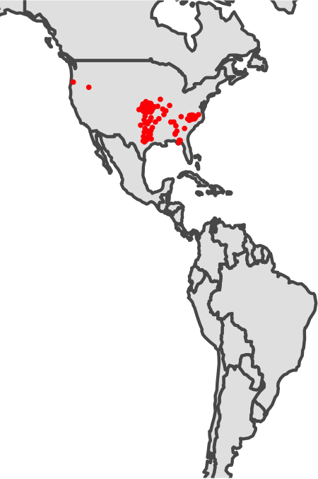
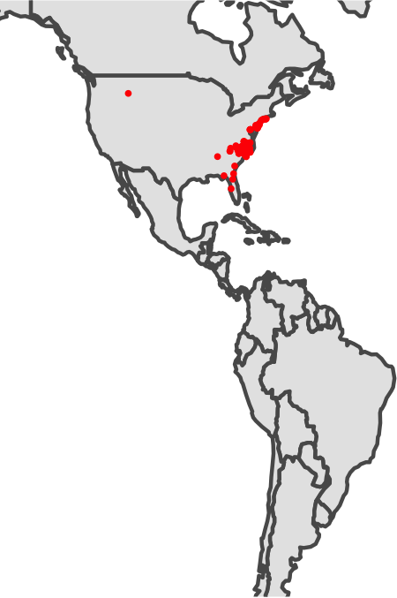
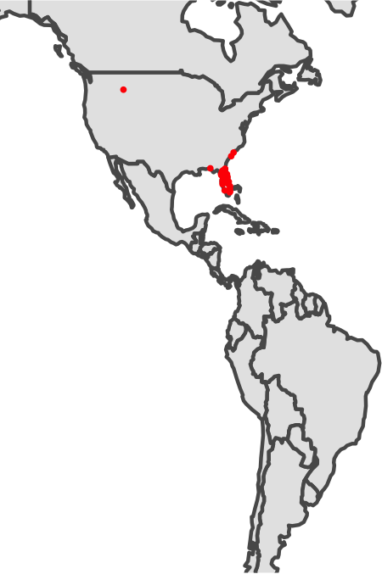
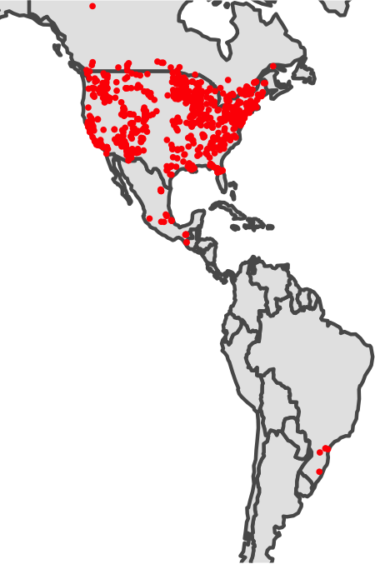
Why use outlier detection?
Abdra brachycarpa
Agalinis setacea
Ampelaster carolinianus
Acer negundo

Slide 3
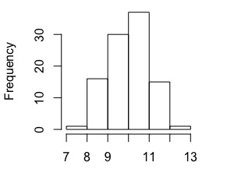
Finding outliers in a distribution

Slide 4
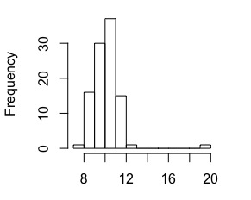
Finding outliers in a distribution

Slide 5
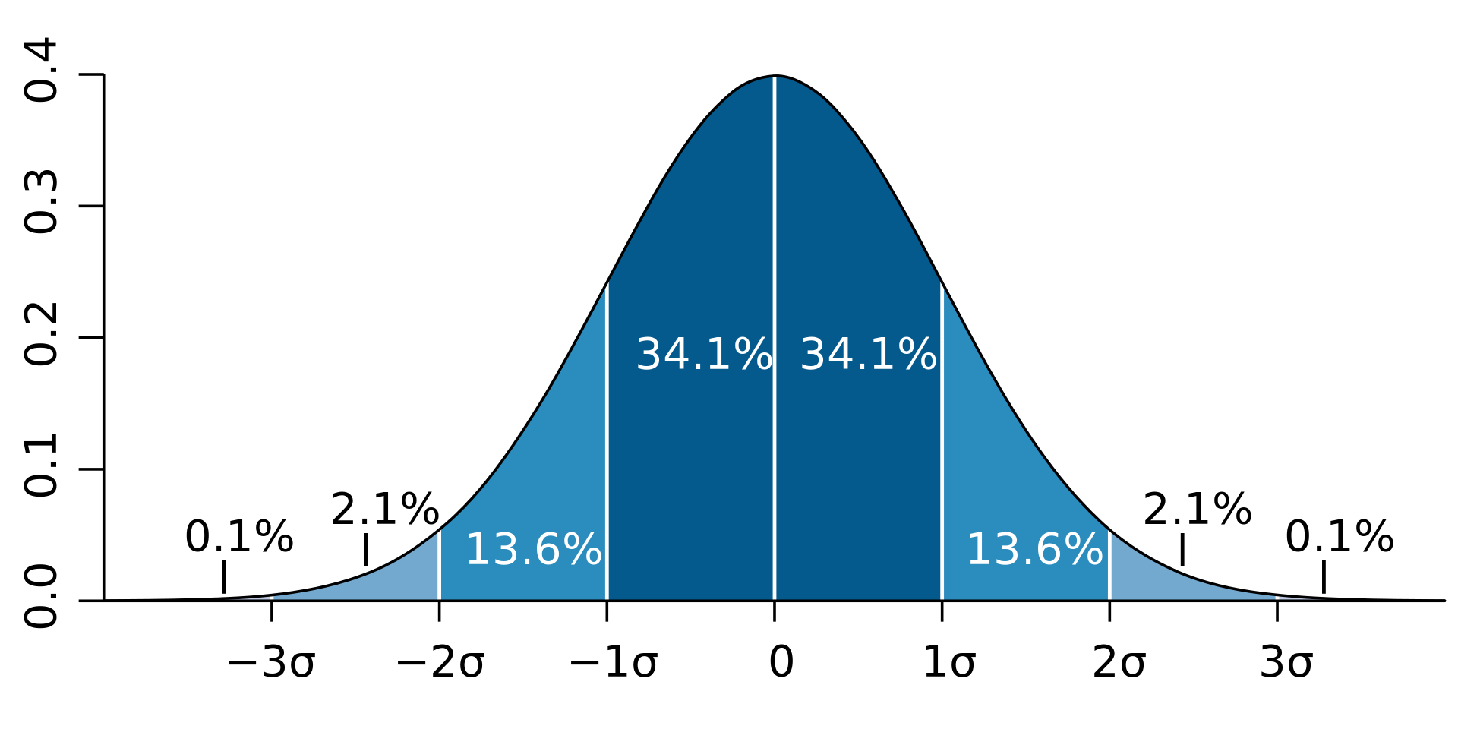
Finding outliers in a distribution
Set a cut-off based of center and breadth of distribution
Mean +/- #SDs
Remove points outside

Slide 6
Creating a distribution for outlier detection with spatial data
Abdra brachycarpa
????

Slide 7
Creating a distribution for outlier detection with spatial data
Get 2-dimensional data to 1-demension

Slide 8
Creating a distribution for outlier detection with spatial data
Get 2-dimensional data to 1-dimension
Calculate a centroid for data cloud

Slide 9
Creating a distribution for outlier detection with spatial data – finding the centroid
Get 2-dimensional data to 1-dimension
Calculate a centroid for data cloud
Calculate distance to centroid for each point

Slide 10
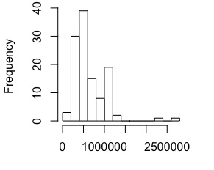
Creating a distribution for outlier detection with spatial data
Abdra brachycarpa
Create distribution of distance to centroid

Slide 11
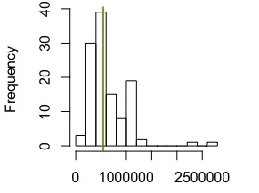
Creating a distribution for outlier detection with spatial data

Slide 12
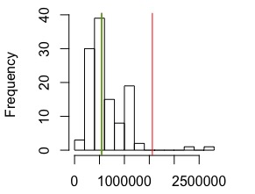
Creating a distribution for outlier detection with spatial data

Slide 13
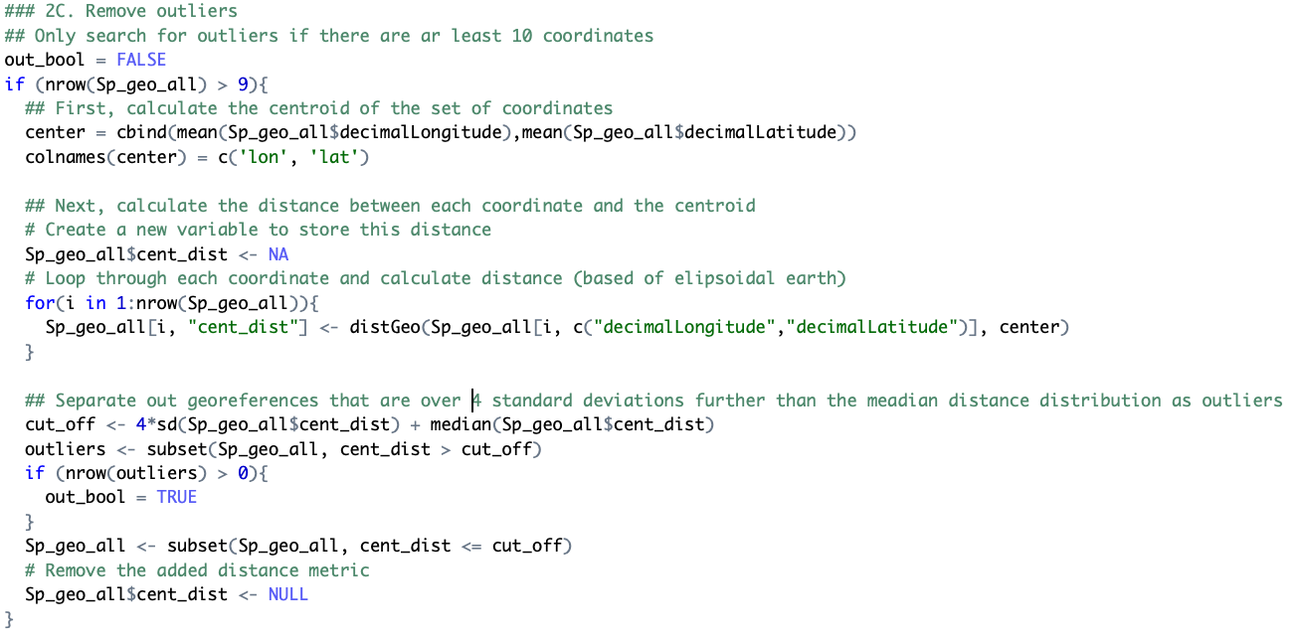
In R Code
Optionally flag outliers
Minimum size of distribution
Create centroid
Calculate distance to centroid
Create a cut off and remove outliers

Slide 14
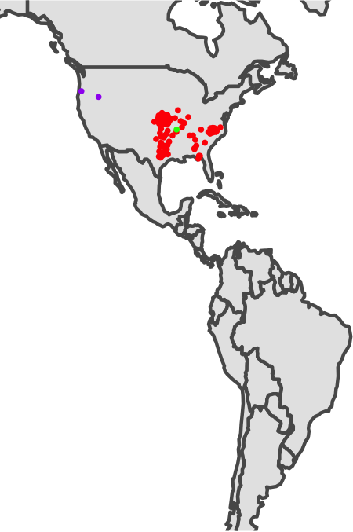

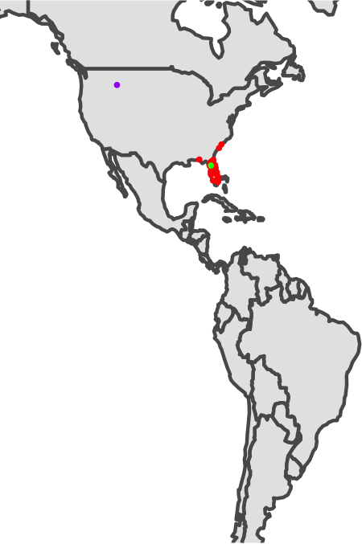
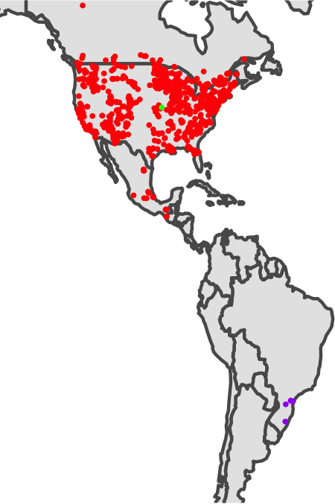
Outliers successfully removed!
Abdra brachycarpa
Agalinis setacea
Ampelaster carolinianus
Acer negundo

Slide 15
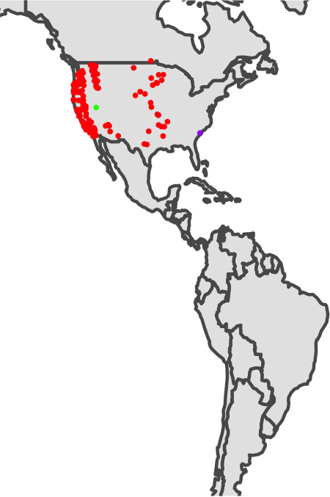
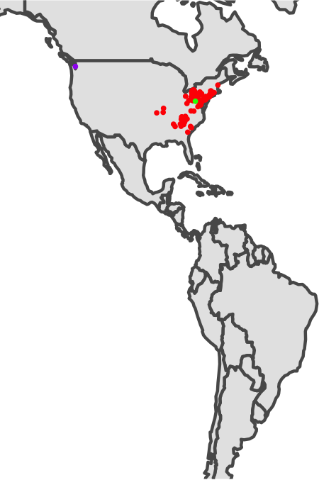

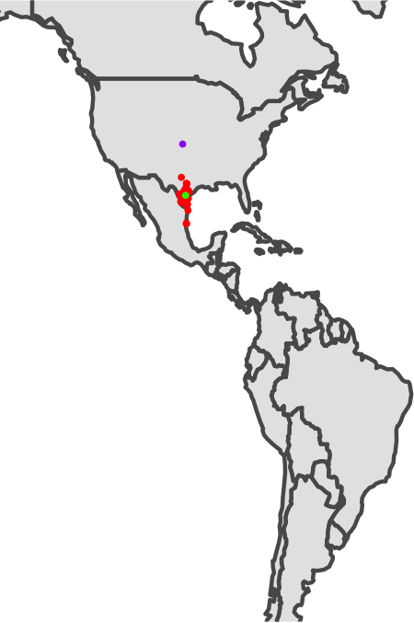
More Examples
Acmispon americanus
Actaea racemosa
Aesculus glabra
Acalypha radians

Slide 16
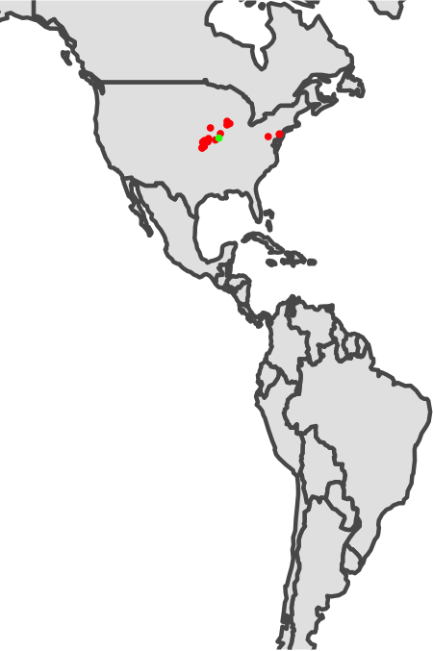
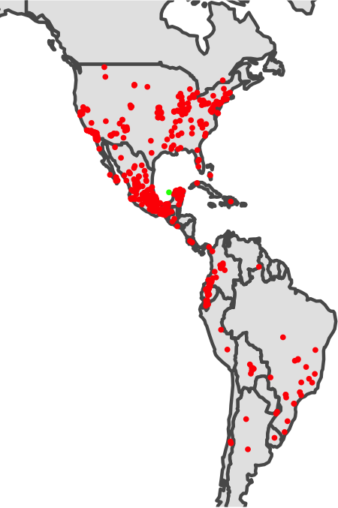
Outliers appropriately not removed
Agalinis auriculata
Amaranthus hybridus

Slide 17
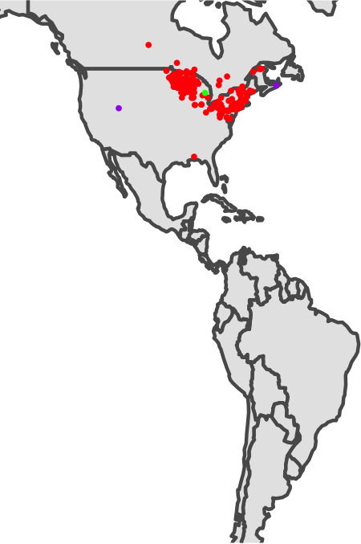
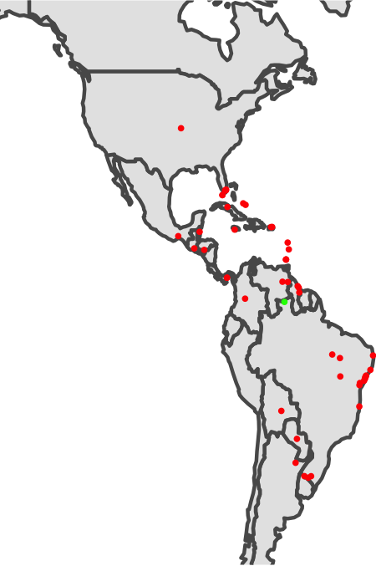
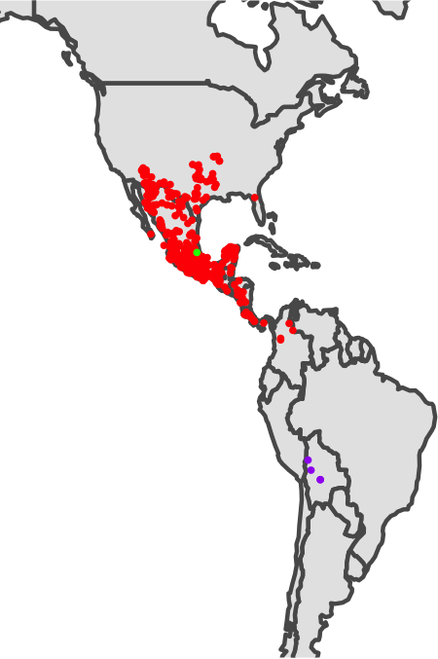
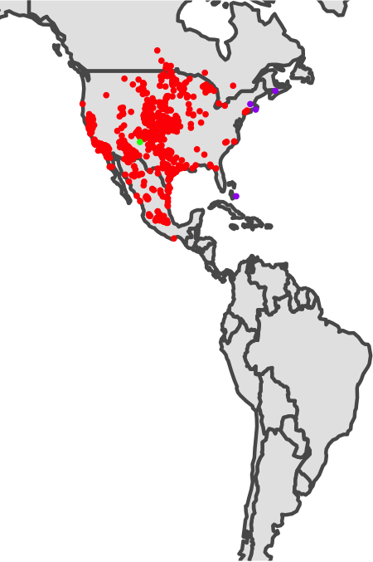
Complications
Inaccuracies
Wide variance
Sampling bias/
true outliers
Widespread with many points
Alnus rugosa
Abilgaardia ovata
Acaciella hirta
Ambrosia psilostachya

Slide 18
Sophistications/Alternatives
Convert lat/lon to geocentric coordinates before averaging
Other methods (e.g., polygon center – not weighted)
Only calculate centroid for points within quantile/percentile
Outliers won’t affect centroid calculation, but could be more strict
For samples with many coordinates, take a random sample of fewer
For abnormal distributions (bimodal), could apply transformation
Calculate mean distance to all other points or use constant cut-off instead of centroid
R package ‘CoordinateCleaner’

